Slide 1

Dormir
[Verb] to sleep
권혁민
김상현
장인애

Slide 3

Contents
01. Problem
02. Difference
03. Overview
04. Demo
05. Future Prospect

Slide 4

#01
Problem
SIMPLE
STRIPE
Notes:
https://jhealthmedia.joins.com/article/article_view.asp?pno=20220#none

Slide 5
#02
Difference
SIMPLE
STRIPE

Slide 6
#03
Overview
SIMPLE
STRIPE

Slide 7
#04
Demo
SIMPLE
STRIPE

Slide 8
#05
Future
Prospect
SIMPLE
STRIPE

Slide 9
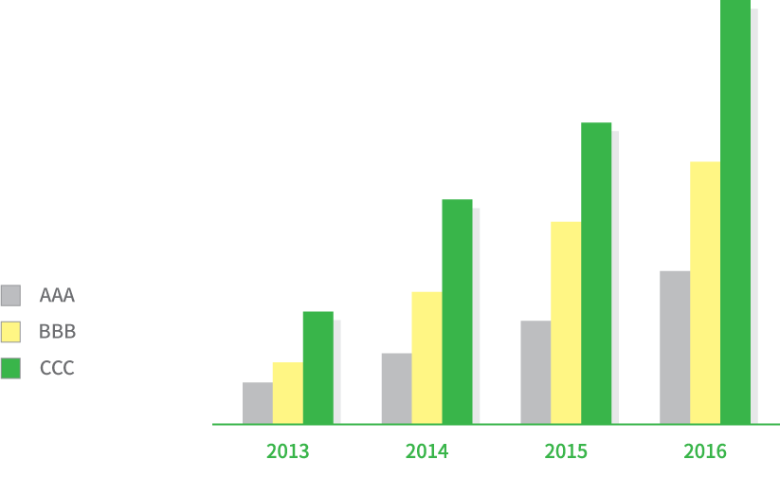
#03
GRAPH

Slide 10

#04
IMAGE

Slide 11
THANK YOU

